Slide 1
Mathematical Economics
Lecture 13

Slide 2
Plan
Taylor’s theorems
Necessary conditions for local max/min
Inverse function theorem
Implicit function theorem

Slide 3


Taylor’s Theorems, $ℝ→ℝ$
$f:I→ℝ$ is $n$ times differentiable;
$I⊂ℝ$ is open;
$[x,x+h]⊂I$.
Then $f\left(x+h\right)=f\left(x\right)+\sum_{k=1}^{n−1}{\frac{f^{\left(k\right)}(x)h^{k}}{k!}}+\frac{f^{\left(n\right)}(x+λh)h^{n}}{n!},λ∈\left(0,1\right);$
and $f\left(x+h\right)=f\left(x\right)+\sum_{k=1}^{n}{\frac{f^{\left(k\right)}(x)h^{k}}{k!}}+o\left(h^{n}\right)$ as $h→0$.
If $f$ is $(n+1)$ times differentiable, then
$f\left(x+h\right)=f\left(x\right)+\sum_{k=1}^{n}{\frac{f^{\left(k\right)}(x)h^{k}}{k!}}+O\left(h^{n+1}\right)$ as $h→0$.

Slide 4
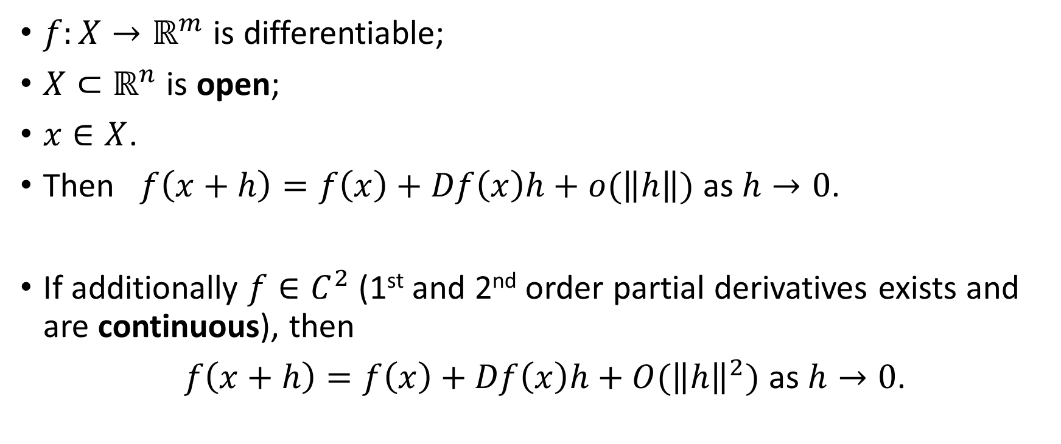

Taylor’s Theorems, $ℝ^{n}→ℝ^{m}$
$f:X→ℝ^{m}$ is differentiable;
$X⊂ℝ^{n}$ is open;
$x∈X$.
Then $f\left(x+h\right)=f\left(x\right)+Df\left(x\right)h+o(\left\|h\right\|)$ as $h→0$.
If additionally $f∈C^{2}$ (1st and 2nd order partial derivatives exists and are continuous), then
$f\left(x+h\right)=f\left(x\right)+Df\left(x\right)h+O({\left\|h\right\|}^{2})$ as $h→0$.

Slide 5
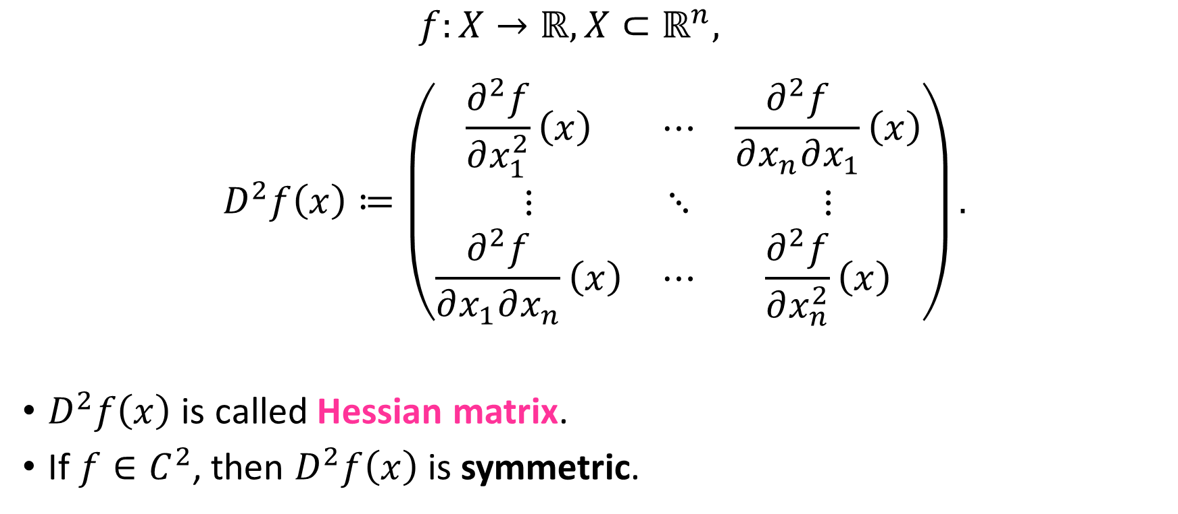
Hessian
$$f:X→ℝ, X⊂ℝ^{n},$$
$$D^{2}f\left(x\right)≔\left(\begin{matrix}\frac{∂^{2}f}{∂x_{1}^{2}}\left(x\right) & ⋯ & \frac{∂^{2}f}{∂x_{n}∂x_{1}}\left(x\right) \\ ⋮ & ⋱ & ⋮ \\ \frac{∂^{2}f}{∂x_{1}∂x_{n}}\left(x\right) & ⋯ & \frac{∂^{2}f}{∂x_{n}^{2}}\left(x\right)\end{matrix}\right).$$
$D^{2}f\left(x\right)$ is called Hessian matrix.
If $f∈C^{2}$, then $D^{2}f\left(x\right)$ is symmetric.

Slide 6
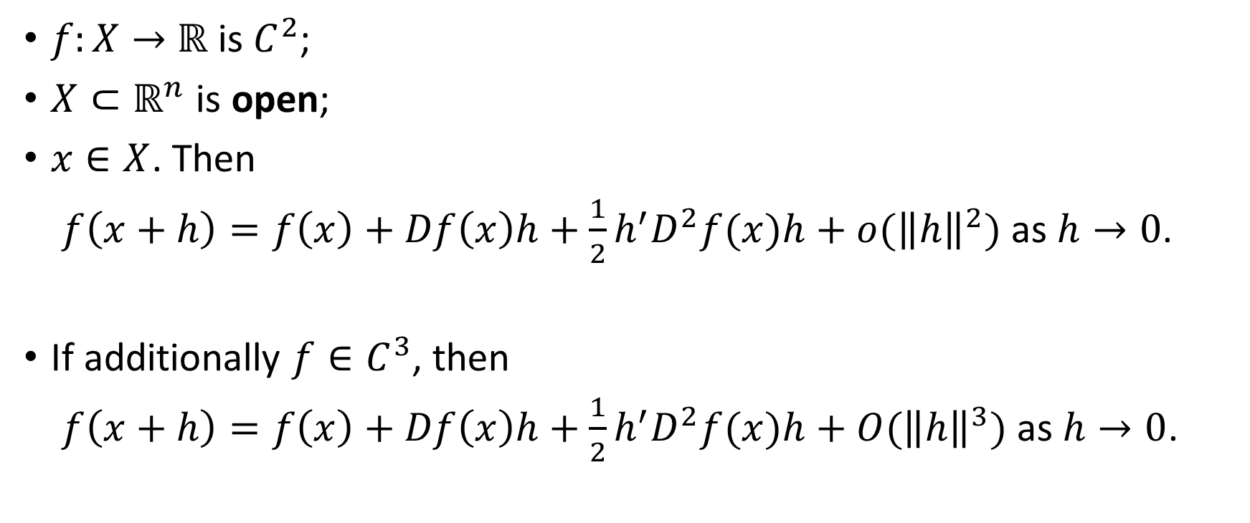

Taylor’s Theorems, $ℝ^{n}→ℝ$
$f:X→$ $ℝ$ is $C^{2}$;
$X⊂ℝ^{n}$ is open;
$x∈X$. Then
$f\left(x+h\right)=f\left(x\right)+Df\left(x\right)h+\frac{1}{2}h^{′}D^{2}f(x)h+o({\left\|h\right\|}^{2})$ as $h→0$.
If additionally $f∈C^{3}$, then
$f\left(x+h\right)=f\left(x\right)+Df\left(x\right)h+\frac{1}{2}h^{′}D^{2}f(x)h+O({\left\|h\right\|}^{3})$ as $h→0$.

Slide 7
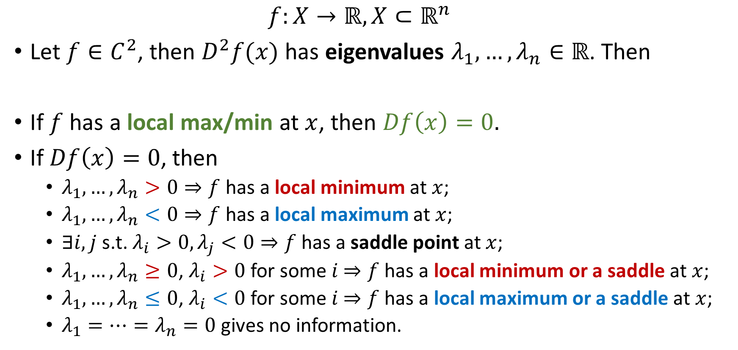
2nd Order Taylor Approximation and Min/Max
$f:X→ℝ, X⊂ℝ^{n}$
Let $f∈C^{2}$, then $D^{2}f(x)$ has eigenvalues $λ_{1},…,λ_{n}∈ℝ$. Then
If $f$ has a local max/min at $x$, then $Df\left(x\right)=0.$
If $Df\left(x\right)=0$, then
$λ_{1},…,λ_{n}>0⇒f$ has a local minimum at $x$;
$λ_{1},…,λ_{n}<0⇒f$ has a local maximum at $x$;
$∃i,j$ s.t. $λ_{i}>0,λ_{j}<0⇒f$ has a saddle point at $x$;
$λ_{1},…,λ_{n}≥0$, $λ_{i}>0$ for some $i$ $⇒f$ has a local minimum or a saddle at $x$;
$λ_{1},…,λ_{n}≤0$, $λ_{i}<0$ for some $i$ $⇒f$ has a local maximum or a saddle at $x$;
$λ_{1}=…=λ_{n}=0$ gives no information.

Slide 8
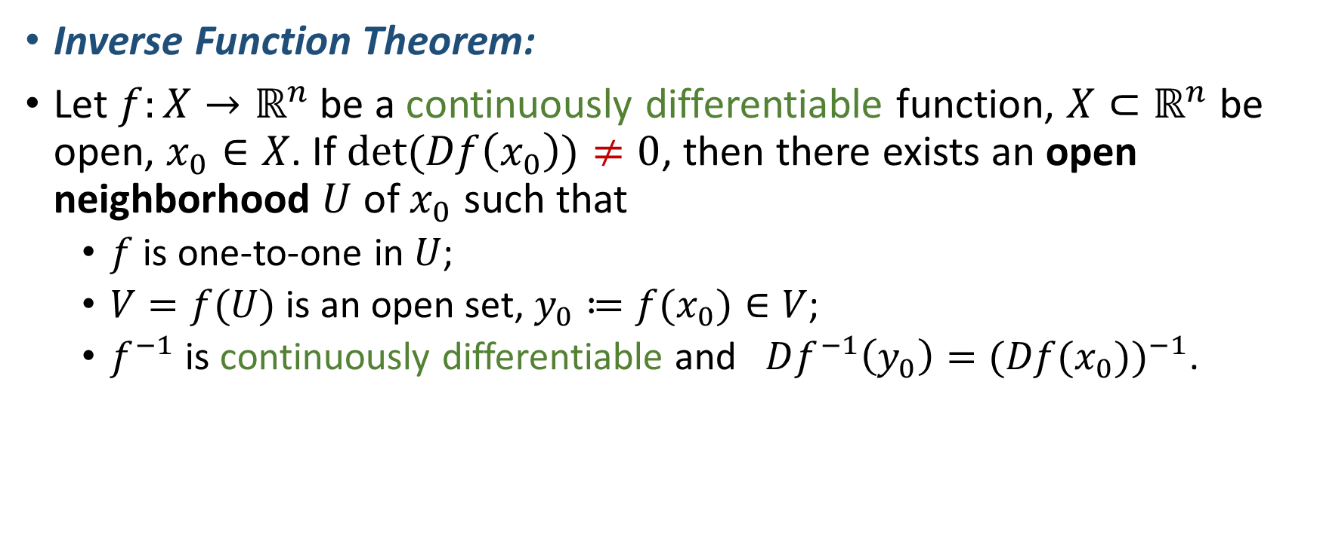
Inverse Function Theorem
Inverse Function Theorem:
Let $f:X→ℝ^{n}$ be a continuously differentiable function, $X⊂ℝ^{n}$ be open, $x_{0}∈X$. If $det⁡(Df\left(x_{0}\right))≠0$, then there exists an open neighborhood $U$ of $x_{0}$ such that
$f$ is one-to-one in $U$;
$V=f(U)$ is an open set, $y_{0}≔f(x_{0})∈V$;
$f^{−1}$ is continuously differentiable and $Df^{−1}\left(y_{0}\right)=(Df(x_{0}))^{−1}$.

Slide 9
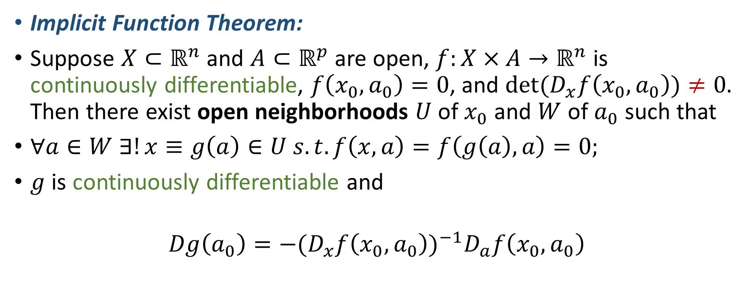
Implicit Function Theorem
Implicit Function Theorem:
Suppose $X⊂ℝ^{n}$ and $A⊂ℝ^{p}$ are open, $f:X×A→ℝ^{n}$ is continuously differentiable, $f\left(x_{0},a_{0}\right)=0$, and $det⁡(D_{x}f\left(x_{0},a_{0}\right))≠0.$ Then there exist open neighborhoods $U$ of $x_{0}$ and $W$ of $a_{0}$ such that
$∀a∈W ∃!x≡g\left(a\right)∈U s.t. f\left(x,a\right)=f\left(g\left(a\right),a\right)=0;$
$g$ is continuously differentiable and
$$Dg\left(a_{0}\right)=−(D_{x}f\left(x_{0},a_{0}\right))^{−1}D_{a}f\left(x_{0},a_{0}\right)$$

Slide 10








Implicit Function Theorem: Illustration
$n=p=1,f\left(x_{0},a_{0}\right)=0,f_{x}^{′}\left(x_{0},a_{0}\right)>0$
$$f\left(x,a_{0}+ε\right)$$
$$f\left(x,a_{0}\right)$$
$$f\left(x,a_{0}−ε\right)$$
$$x$$
$$g\left(a_{0}+ε\right)$$
$$x_{0}$$
$$g\left(a_{0}−ε\right)$$

